Slide 1
CS 464 Project
Telecom Customer Churn Rate Prediction
Group 5 Alba Mustafaj 21500009
Alp Ege Baştürk 21501267
Berat Biçer 21503050
Bora Ecer 21501757
H. Buğra Aydın 21501555

Slide 2

Project Description
The objective of this project is predicting user’s churn rate, which occurs when a customer stops using the service.
Predicting whether a customer is leaving or not at the end of the contract term is done by looking at the customer’s data according to the features determined at the time of training.
Person in doubt [1]
Notes:
Churn rate (sometimes called attrition rate), is a measure of the number of individuals or items moving out of a collective group over a specific period. It is one of two primary factors that determine the steady-state level of customers a business will support.

Slide 3
Dataset Description
The dataset to be used is that of Telco’s Customer Data [2]
The raw data contains 7043 rows (customers) and 21 columns (features).
customerID Customer ID | gender Customer gender (female, male) | SeniorCitizen Whether the customer is a senior citizen or not (1, 0) | Partner Whether the customer has a partner or not (Yes, No) | Dependents Whether the customer has dependents or not (Yes, No)

Slide 4
Features
customerID
Gender,
SeniorCitizen
Partner,
Dependents
Tenure
PhoneService
MultipleLines
InternetService
OnlineSecurity
OnlineBackup,
DeviceProtection
TechSupport
StreamingTV
StreamingMovies
Contract
PaperlessBilling
PaymentMethod
MonthlyCharges
TotalCharges
Churn
Notes:
customerID
Customer ID
gender
Customer gender (female, male)
SeniorCitizen
Whether the customer is a senior citizen or not (1, 0)
Partner
Whether the customer has a partner or not (Yes, No)
Dependents
Whether the customer has dependents or not (Yes, No)
tenure
Number of months the customer has stayed with the company
PhoneService
Whether the customer has a phone service or not (Yes, No)
MultipleLines
Whether the customer has multiple lines or not (Yes, No, No phone service)
InternetService
Customer’s internet service provider (DSL, Fiber optic, No)
OnlineSecurity
Whether the customer has online security or not (Yes, No, No internet service)
OnlineBackup
Whether the customer has online backup or not (Yes, No, No internet service)
DeviceProtection
Whether the customer has device protection or not (Yes, No, No internet service)
TechSupport
Whether the customer has tech support or not (Yes, No, No internet service)
StreamingTV
Whether the customer has streaming TV or not (Yes, No, No internet service)
StreamingMovies
Whether the customer has streaming movies or not (Yes, No, No internet service)
Contract
The contract term of the customer (Month-to-month, One year, Two year)
PaperlessBilling
Whether the customer has paperless billing or not (Yes, No)
PaymentMethod
The customer’s payment method (Electronic check, Mailed check, Bank transfer (automatic), Credit card (automatic))
MonthlyCharges
The amount charged to the customer monthly
TotalCharges
The total amount charged to the customer
Churn
Whether the customer churned or not (Yes or No)

Slide 5
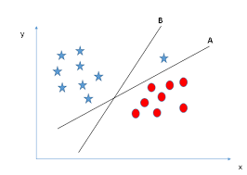
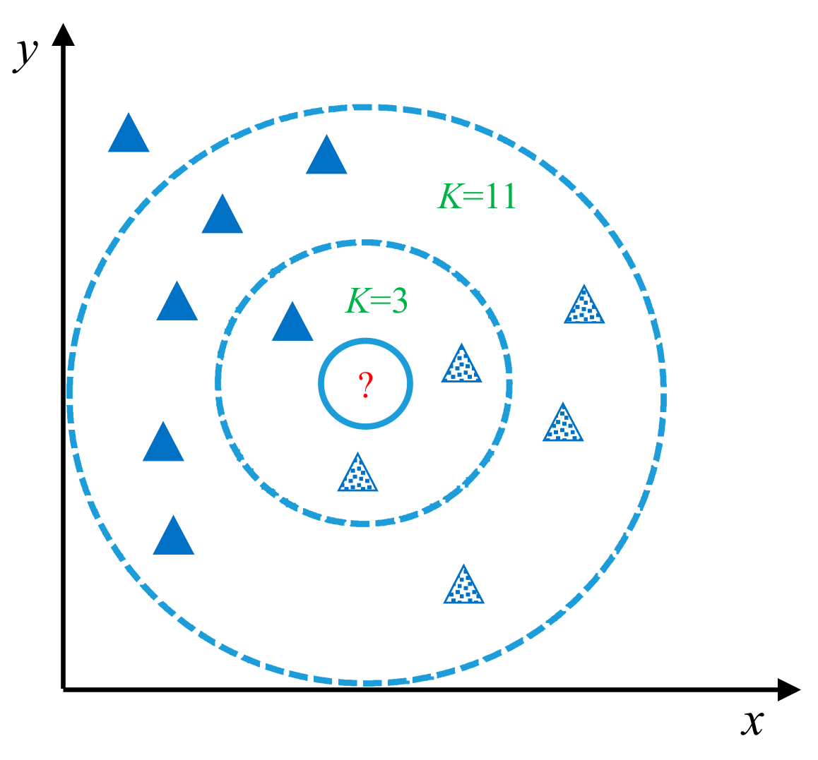
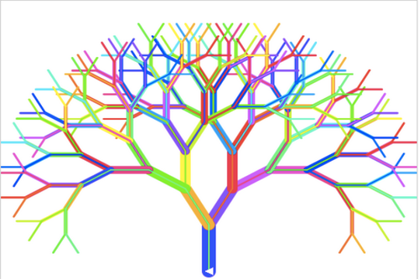
Training process
We will be using different machine learning methods like:
SVM
kNN
logistic regression
decision tree classification
random forest classification
Success of different methods will be compared to find optimal one(s).
SVM [4]
Knn [3]
Random forest [5]

Slide 6
Results and Expectations
We expect to see the relation between user data and churning.
It’s expected that customers with long tenure and seniority are less likely to churn.
Hidden features may be discovered during the process as well

Slide 7
References
[1] Person in doubt, [Online]. Available: https://www.psychologytoday.com/au/blog/children-the-table/201806/when-child-tells. [Accessed: Oct. 11, 2018]
[2] Blast Char ”Telco Customer Churn”. Kaggle. [Online]. Available: https://www.kaggle.com/blastchar/telco-customer-churn. [Accessed: Oct. 2, 2018]
[3] knn Graph, [Online]. Available: https://www.google.com.tr/search?q=knn&source=lnms&tbm=isch&sa=X&ved=0ahUKEwi2xc-fgf_dAhXF_CoKHcdcAfoQ_AUIDygC&biw=1366&bih=613#imgrc=zWukqNn05iZXEM: [Accessed: Oct. 11, 2018]

Slide 8
References
[4] SVM Graph, [Online]. Available: https://www.analyticsvidhya.com/wp-content/uploads/2015/10/SVM_1.png. [Accessed: Oct. 11, 2018]
[5] Random forest animation, [Online]. Available: https://www.google.com.tr/url?sa=i&rct=j&q=&esrc=s&source=images&cd=&cad=rja&uact=8&ved=2ahUKEwim3Kjlgv_dAhUFzaQKHd0XCJ0QjRx6BAgBEAU&url=http%3A%2F%2Fcagriemreakin.com%2Fveri-bilimi%2Frandom-forest-classification-10.html&psig=AOvVaw3CyZGO5GS--DYwxZ2S1bZL&ust=1539369042818892. [Accessed: Oct. 11, 2018]

